Slide 1
Week 1
CIS 347 / SOC 395
Introduction to Digital Forensics

Slide 2
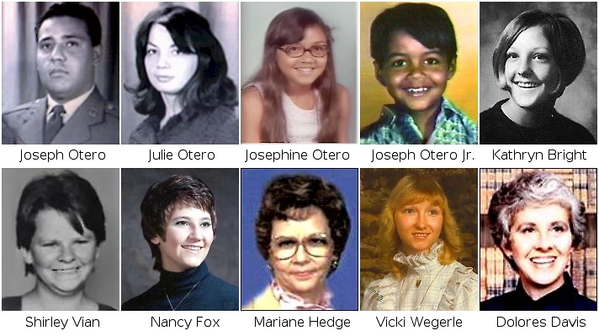
Digital Forensics

Slide 3
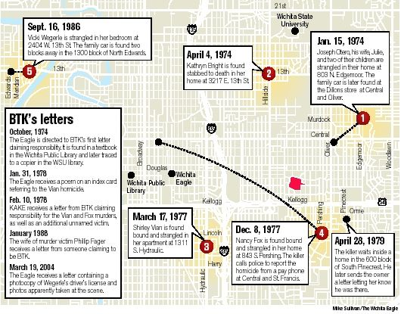
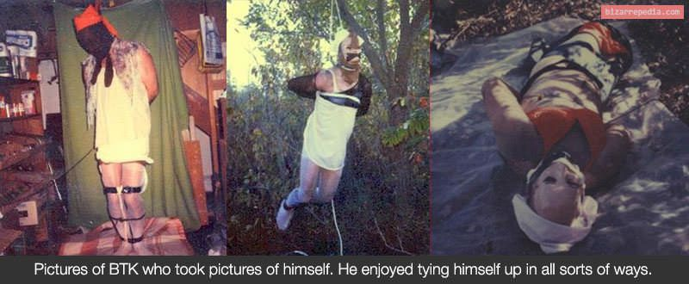
BTK

Slide 4
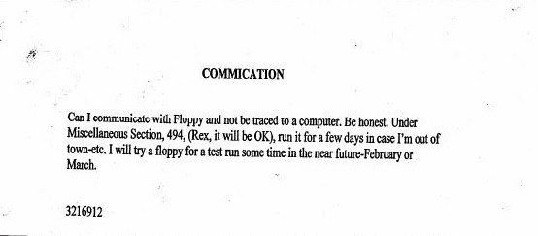
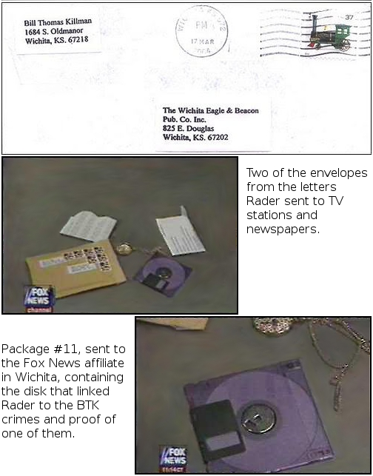
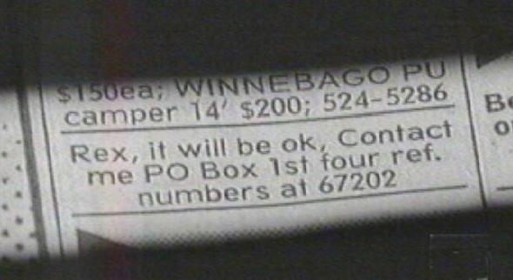
BTK

Slide 5
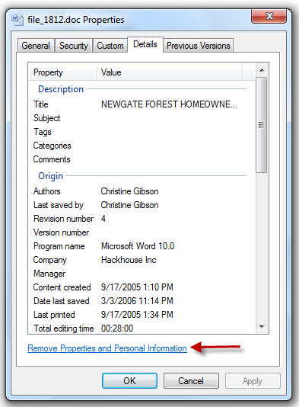
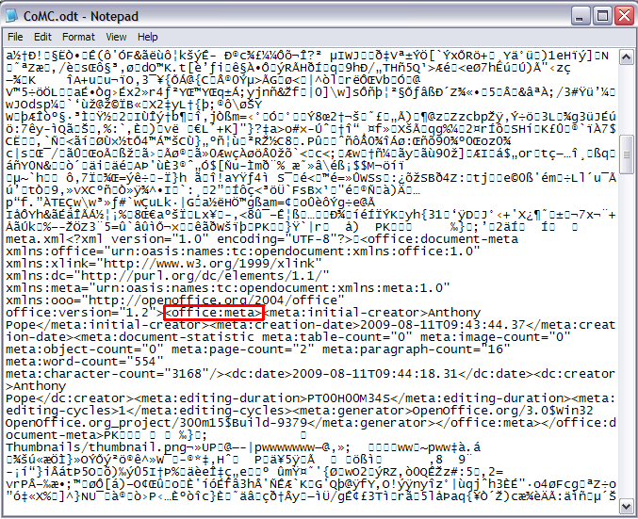
BTK

Slide 6
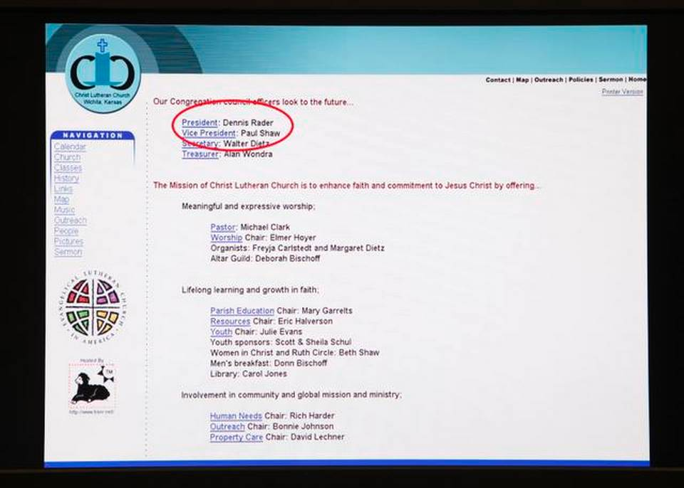
BTK

Slide 7
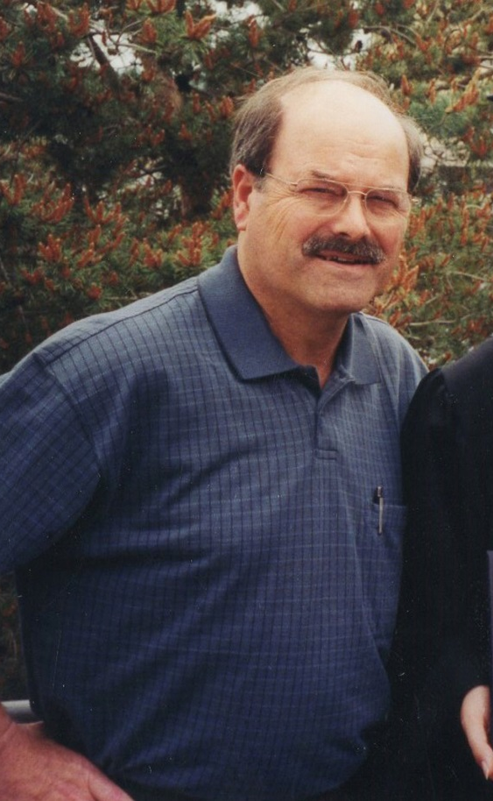
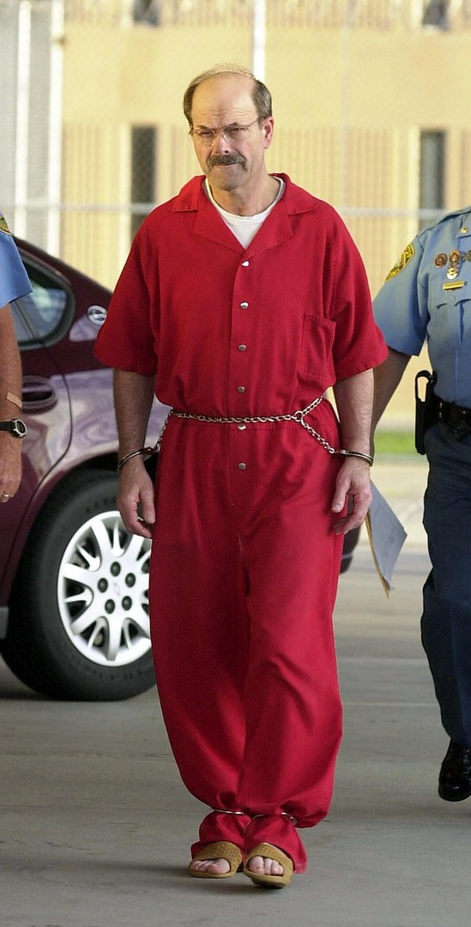
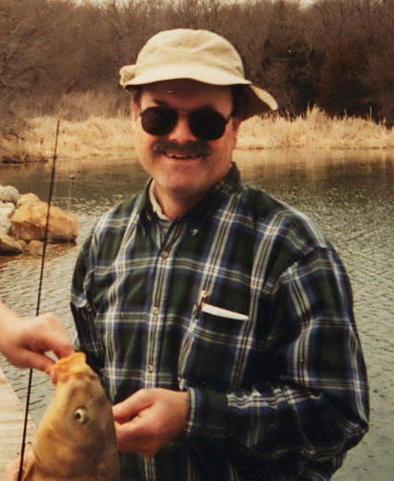
BTK

Slide 8
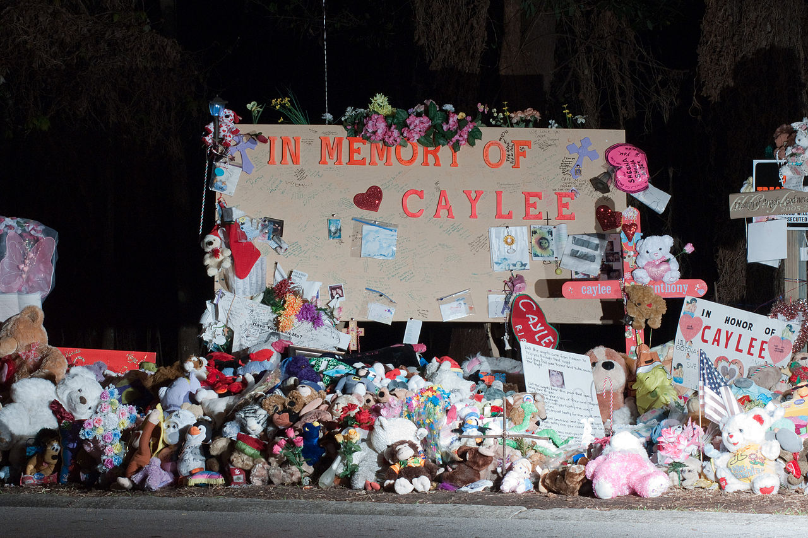

Slide 9


Slide 10
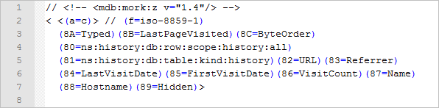
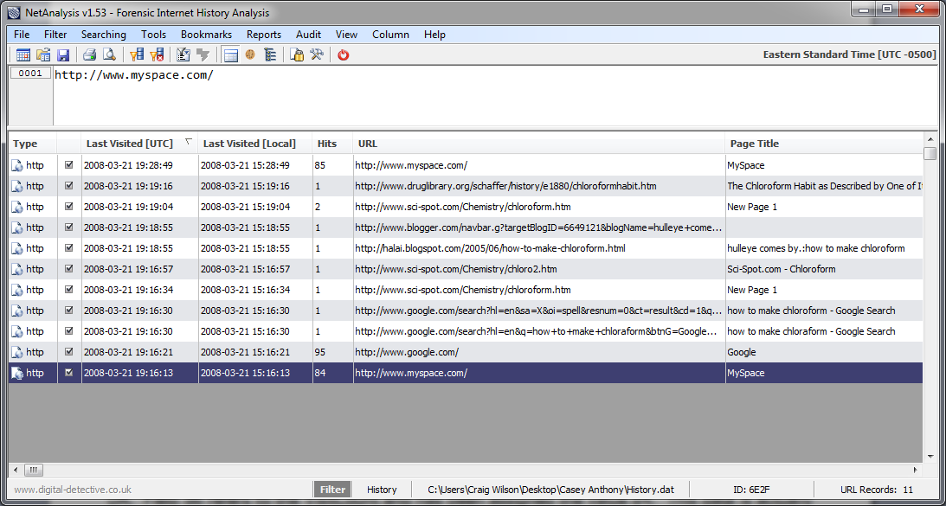

Slide 11

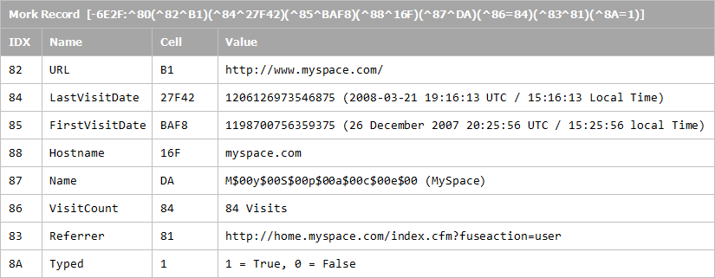

Slide 12
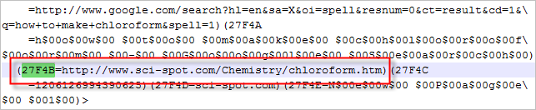
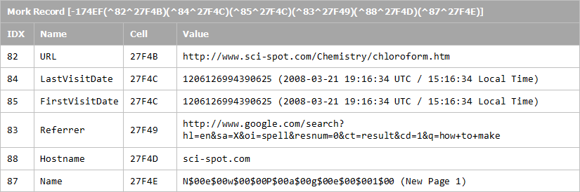

Slide 13
Digital Forensics
“The collection of data from computers and other digital devices in the interest of obtaining, analyzing, verifying, and preserving that data.”
No distinction between criminal or civil, legal or civilian. There are digital forensic applications that pertain to numerous industries in both the public and private sectors.

Slide 14
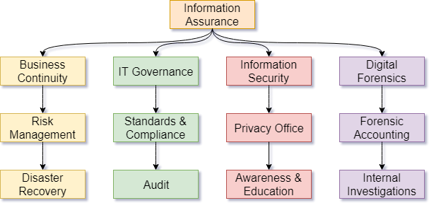
Information Assurance Tree
Note: This is not prescriptive. Each organization is different (either a little or a lot), but this is roughly the way things are out in the world.
C-I-A

Slide 15
Applications of Digital Forensics
“Criminals, violent and white-collar alike, are using technology to facilitate their offenses and avoid apprehension, creating new challenges for attorney’s, judges, law enforcement agents, forensic examiners, and corporate security professionals.” – Casey, pg 3.
Includes:
Terrorist and extremists using the Internet to plan and carry out attacks.
State-sponsored hackers influencing elections and controlling the zeitgeist.
Violent serial offenders use technology to fulfill a ritual component of communiques.
Suicides due to bullying, stalking, and harassment. Some attributable to instances of gang stalking or acts of sadism.
Cases of corporate espionage and data breaches.
Just about every crime committed in our contemporary era involves email, a cell phone, dash cam, the Internet, whatever.

Slide 16
Introduction to Computer Investigations
These days, digital forensics is a field that encompasses all crimes which utilize, in whole or in part, computers or technical devices. In short: All crimes.
It is also a critical skillset in the private sector:
Intellectual Property theft
Industrial/corporate espionage and data breaches
Employment disputes
Fraud investigations
Forgeries
Bankruptcy investigations
Inappropriate email and internet use in the workplace
Regulatory compliance

Slide 17
Introduction to Computer Investigations
Example (criminal) case:
On December 17th, 2000, Air Force Captain Marty Theer was shot and killed. The case took a turn as there were no eyewitnesses and no physical evidence.
However, the prosecutors were able to get their hands on 88,000 e-mails and other messages on a computer belonging to Captain Theer’s wife Michelle’, and discovered personal ads that Michelle had posted in 1999.
They also found email responses by her for that ad which showed clear evidence of a sexual relationship between Michelle and a man named John Diamond.
Furthermore, messages containing information about the conspiracy to murder Captain Marty were also recovered.
On December 3rd, 2004, Michelle Theer was found guilty of murder and conspiracy and sentenced to life imprisonment.

Slide 18
Introduction to Computer Investigations
Example (non-criminal) case:
An official investigation was launched in August of 2007 by the Securities and Exchange Commission’s Office of the Inspector General (SEC OIG).
Initial evidence showed a vast misuse of government computers and networks, and attempts to circumvent security measures from within the SEC.
This caused the investigation to expand. In the end, it turned out there had been an erosion of security due to the use of government computers to access pornographic materials:
An accountant with over 16,000 denials from perimeter security measures for access to adult material.
Over 45,000 individual pornographic images.
Several cases of government property being destroyed due to hard drives being filled to the gills with porn and malware.

Slide 19
Digital Evidence
“Any data stored or transmitted using a computer that supports or refutes a theory of how an offense occurred or that addresses criminal elements of the offense such as intent or alibi” –Casey, pg 7.
Mobile
Phone call logs, text messages, app data, triangulation logs
Endpoint
Network packet caps and logs, OS artifacts, data on disk, even “deleted” data, volatile data (memory, in CPU registers, etc.), Internet search history, IP routing information
It involves the examination of evidence from computers of all types, mobile devices, and often unconventional devices like GPS units, automobile computers, printers, etc.

Slide 20
Computers make their own records
Computers create transaction logs of many activities, including logging in, sending and receiving email, saving and retrieving files, connecting to the Internet, and many other applications
Electronic documents, photos, and email contain hidden information that is very helpful to investigators; this information may include dates and times, address and routing information, deleted and edited data, and more

Slide 21
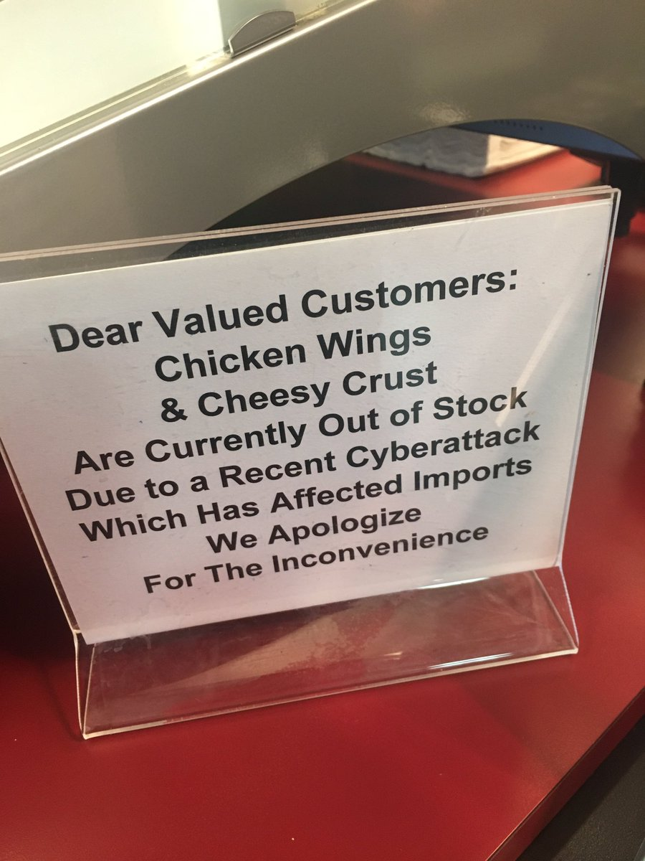
No computer is an island
Computers rarely stand alone; any two or more connected digital devices create a network; networked devices communicate with each other and share information; sometimes, a computer can be controlled from a remote location.
All digital information is located SOMEWHERE, not in an imaginary “cyberspace” or cloud, but on a computer, a server, or some other digital storage device.

Slide 22
Why you should NOT become a digital forensic scientist
You see horrible things.
Your whole job is to be obsessed with details.
You must follow a lot of rules that don’t make logical sense but make attorneys / jurors “feel” better. (scientific conclusions v. legal decision-making)
It is a defense attorney’s whole job to pick apart your work and attack your credentials, competency, character, reputation, methods, etc.
If you make a mistake, it is a big deal. Possibly leading to a perversion of justice.
You do more paperwork than a cop, but less respect. (The Blue Magnet does not extend to hired geeks.)
You might never get to know the outcome of your work.
You must always be learning and keeping up with trends - progress stops for no one, and it is more important for you than ANY other IT position to stay competent.
The way tech has been heading, your job only gets harder and harder and harder. Built-in encryption, cloud storage, ever-evolving malware, for example.
You might do EVERYTHING RIGHT and STILL fail.

Slide 23
Why you should become a digital forensic scientist
Because you can.
Someone must.

Slide 24
Locard’s Exchange Principle
"Wherever he steps, whatever he touches, whatever he leaves, even unconsciously, will serve as a silent witness against him. Not only his fingerprints or his footprints, but his hair, the fibers from his clothes, the glass he breaks, the tool mark he leaves, the paint he scratches, the blood or semen he deposits or collects. All of these and more, bear mute witness against him. This is evidence that does not forget. It is not confused by the excitement of the moment. It is not absent because human witnesses are. It is factual evidence. Physical evidence cannot be wrong, it cannot perjure itself, it cannot be wholly absent. Only human failure to find it, study and understand it, can diminish its value."
“Every contact leaves a trace.”

Slide 25
History of Digital Forensics

Slide 26
Timeline of Forensic Science
3rd Century:
First known use of forensic science in China
Pre-17th Century:
In the western world, forensic science amounts to the old “witch test” and “torture tests.”

Slide 27
Timeline of Forensic Science
19th Century:
Toxicological evidence at trial become accepted and commonplace.
Photographs become common for documenting crime scenes.
A technique known as Anthropometry becomes common for identifying people.
20th Century:
Blood typing is discovered.
Fingerprinting replaces Anthropometry.
First crime labs established.

Slide 28
Timeline of Digital Forensics
The Ad Hoc Era (‘76 to ‘92):
1976 – The first text on the topic, Crime by Computer by Don Parker is published. It covers the use of digital information to investigate and prosecute crimes committed with the assistance of a computer. At the time, computer systems were rare and expensive. There was no such thing as Information Security, and any digital forensics were the byproduct of system admins running audits to ensure efficiency (as data processing was expensive at the time.)

Slide 29
Timeline of Digital Forensics
The Ad Hoc Era (‘76 to ‘92):
Digital forensics as a career begins with the IRS, and soon followed by the DoD and FBI, who hire and train individuals in mainframe/terminal and mini-computers for the purpose of assisting case investigators in obtaining information from computer systems.

Slide 30
Timeline of Digital Forensics
The Ad Hoc Era (‘76 to ‘92):
1990 – An early computer investigator named Cliff Stoll is attempting to reconcile a variance between two accounting programs and identifies hackers' access to one of the systems. By applying the scientific method and a significant amount of effort, he develops a method of recording the hackers’ activities in real time. He also publishes a book called The Cuckoo’s Egg about the experience.

Slide 31
Introduction to Computer Investigations
In those early days there was no official organization, governing body, or certification board. There were no standards outside of those imposed by self and peers. This soon changed as the field became formalized. The first organizations were those created by various LEOs as an official response to the need for digital forensics.
IRS – Seized Computer Evidence Recovery Specialists (SCERS)
US SS – Electronic Crimes Special Agent Program (ECSAP)
FBI – Computer Analysis Response Team (CART)

Slide 32
Timeline of Digital Forensics
The Dawn of the Information Age (‘93 to ’01):
In 1993 the FBI hosts the First International Conference on Computer Evidence in Quantico, VA.
The Internet was only just becoming A Thing, so much of the focus was on recovering data from standalone computers. However, as hackers began to use modems to access remote computers these early forensic detectives had a completely new set of challenges to face. Imagine a traditional crime scene – all your facts are present. In this new paradigm, your crime scene could be spread over numerous telecom and computer systems.

Slide 33
Timeline of Digital Forensics
The Dawn of the Information Age (‘93 to ’01):
By the mid-90s, interest in digital forensics exploded for two reasons – First, computers became ubiquitous. Second – the ability to practically share files and lack of oversight allowed an explosion in child-exploitation cases, which is generally regarded as beginning with the George Burdynski Jr case in 1993 which led to the formation of task forces across many LEOs.

Slide 34
Timeline of Digital Forensics
The Dawn of the Information Age (‘93 to ’01):
The increased interest led to increased scrutiny, and the field of digital forensics became more formalized. Previously, experts were either self-declared or locally recognized “resident experts.” Soon there was a major effort to form accreditation standards and bodies to establish them.

Slide 35
Timeline of Digital Forensics
The Dawn of the Information Age (‘93 to ’01):
Things continued much in this fashion for the remaining years, with LEO and private sector investigators largely playing catch-up to the explosion of technology. Then 9/11 happened, and the influx of money, political will, and broad granting of powers led to a new age for digital forensics.

Slide 36
Timeline of Digital Forensics
Contemporary Age (‘01 to Present):
Technology is accepted and integrated into the way we access and share information. In some ways it is integrated into other aspects of our lives (such as fitness watches, commercial drones.)
Laws surrounding the use and abuse of technology are codified.
The number of digital forensic labs has grown, the number of digital forensic practitioners has grown, but neither at a rate necessary to keep up with the need.

Slide 37
Applications of Digital Forensics
Technology is ubiquitous in our lives. We all use computers. We all have cell phones. We cannot walk across the street without being videotaped by surveillance cameras or ending up being in someone else’s selfie.
This is getting MORE important, not less, as we now stand on the cusp of a new era where technology doesn’t merely support our lives but supplements it. Interconnected devices, self-driving cars, and other technologies will soon revolutionize our world – but with progress comes problems.

Slide 38
Applications of Digital Forensics
Our digital age also brings with it a plethora of heretofore unheard of problems in communication (and thus in criminal acts.) There are several inherent characteristics of modern communication methods that tend to complicate matters.
Anonymity
Constant connectivity
Permanence
Depersonalization

Slide 39
“Going Dark”
Unfortunately, an abundance of technology does not automatically bring an abundance of forensic experts. This has led to a significant gap.
Some estimates are that up to 98% of all criminals leave some digital evidence of their crime, which could be collected and analyzed through computer forensics.
In our age, a lack of that evidence can make it nearly impossible to solve a case – See Philip Welsh for an example.
While automated tools CAN be created, these are trivially spoiled by countermeasures such as encryption and steganography – you just cannot remove the investigator from investigations.
Experts call this personnel / knowledge gap, and subsequent lack of viable evidence, “Going dark.”

Slide 40
“Going Dark”
With this in mind, it’s all the more alarming that the IoT is bringing us an ever-connected life.
These skills become even more important was we do more and more online. Without people trained in this discipline, we will miss out on critical events, such as being able to identify when large groups of individuals allegedly attempt to control the narrative and influence an entire national election.
https://www.fireeye.com/blog/threat-research/2018/08/suspected-iranian-influence-operation.html

